Slide 1
Shell IDSO Custom Bootcamp 2024 3 Reflections for Week 3
Cherry Chopra
Date : 13-Sep-2024

Slide 2

About Me
Everything happens for a reason.

Slide 3

My learnings from this week!

Slide 4
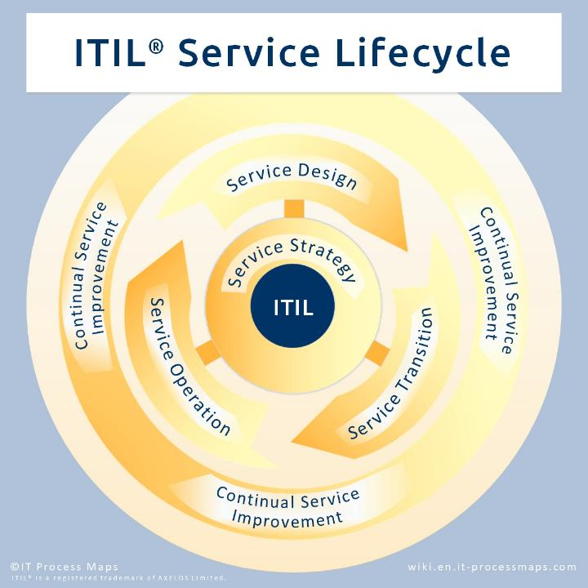
Learning 1 | My takeaways
Key learning:
Concepts of ITIL and ITSM and implementation through ServiceNow.
Key takeaway:
Understood the concepts of Information Technology Infrastructure Library and how it is used with the help of the ITIL tool ServiceNow. Learnt about various concepts in SeviceNow like change management, incident management etc.
How do I personally see this concept implemented in the Energy sector:
Leveraging ServiceNow and ITIL can help in smooth resolution of incidents and problems and enhance IT user experience.

Slide 5
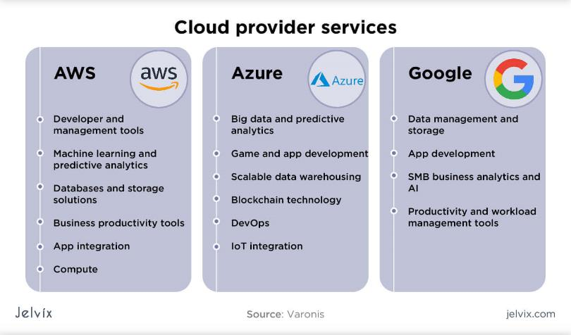
Learning 2 | My takeaways
Key learning:
Fundamentals of Cloud and AWS.
Key takeaway:
Understood the concepts relating to cloud like IaaS, PaaS, SaaS and the differences in the services offered by AWS and Azure for creating virtual machines. Learnt AWS concepts relating to EC2 instance and S3 bucket.
How do I personally see this concept implemented in the Energy sector:
It can help in reducing costs relating to purchase and maintenance of servers by leveraging cloud-based services.

Slide 6
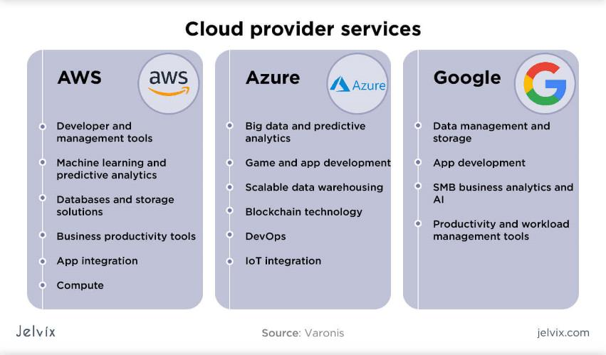
Learning 3 | My takeaways
Key learning:
Implementation of virtual machines and related functions in Azure cloud
Key takeaway:
Understood concepts relating to Azure cloud - connecting to virtual machines using SSH, configuring virtual networks and subnets and using public and private IP addresses.
How do I personally see this concept implemented in the Energy sector:
Using cloud-based solutions could help in cost cutting and increasing profits along with enhancing security.

Slide 7

Relevance of learnings for my organization

Slide 8
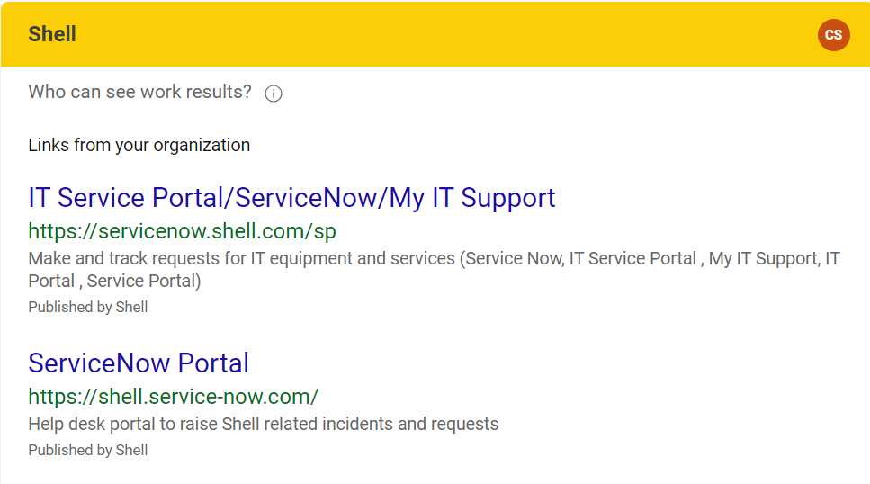
Learning 1 | Relevance for Shell
How I feel Shell implements this learning:
Shell makes use of the various features of ServiceNow to streamline its IT issues and ticketing (ITSM) system, to ensure smooth functioning of its IT related functions.
How I feel Shell benefits from this learning:
Shell is able to reduce downtime and thus preventing any losses relating to IT failures. This also helps in enhancing user experiencing ensuring a pleasant experience for not only the end users but also the IT support staff.

Slide 9
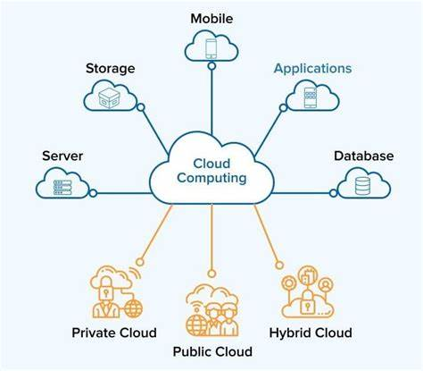
Learning 2 | Relevance for Shell
How I feel Shell implements this learning:
Shell uses cloud to reduce storage and maintenance costs and also ensure the safety of its data along with leveraging all the additional features of cloud.
How I feel Shell benefits from this learning:
Shell enhances its data security at the same time lowering costs and increasing profits through cloud-based solutions.

Slide 10
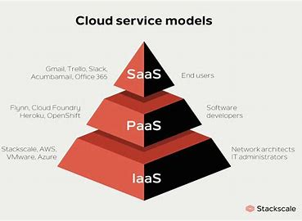
Learning 3 | Relevance for Shell
How I feel Shell implements this learning:
Shell uses cloud-based SaaS like PowerBI and PowerApps. IaaS like Azure is also used. Azure helps in using Virtual Machines and Storage accounts.
How I feel Shell benefits from this learning:
Shell is able to reduce costs and efforts in infrastructure maintenance and is able to enhance accessibility through storing data on and using services on the cloud. It also enhances security and reduces risk.

Slide 11

Challenges in implementing learning

Slide 12
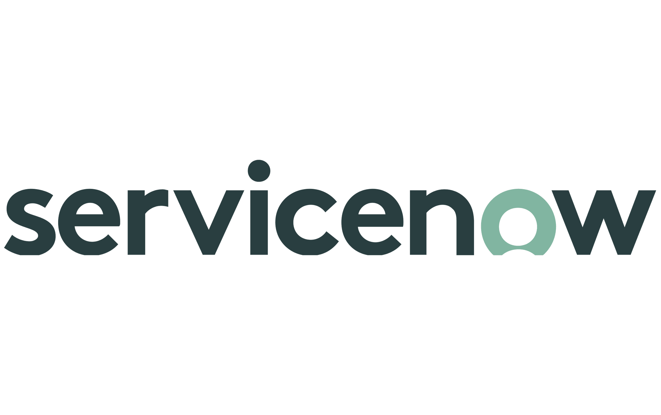
Challenge faced while implementing Learning 1
What were the challenges I faced while implementing Learning 1 and my plan to overcome them:
Understanding the ServiceNow interface and implementing the given tasks with a proper workflow.

Slide 13

Challenge faced while implementing Learning 2
What were the challenges I faced while implementing Learning 2 and my plan to overcome them:
Understanding the different commands and features of AWS platform and its working.

Slide 14
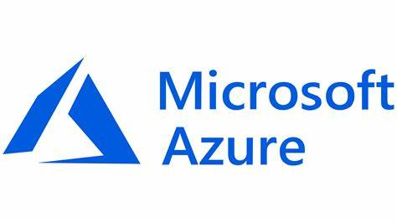
Challenge faced while implementing Learning 3
What were the challenges I faced while implementing Learning 3 and my plan to overcome them:
Understanding the different commands and features of Azure platform and its working.

Slide 15

Learning is also Fun!

Slide 16
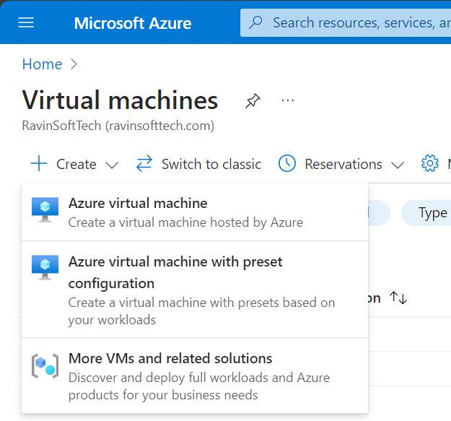
Learning is also Fun!
We practiced ServcieNow, Azure and AWS hands-on on our systems and were able to create and resolve tickets on ServiceNow and Virtual Machines using Microsoft Azure and AWS.

Slide 17
Thank You

